Slide 1
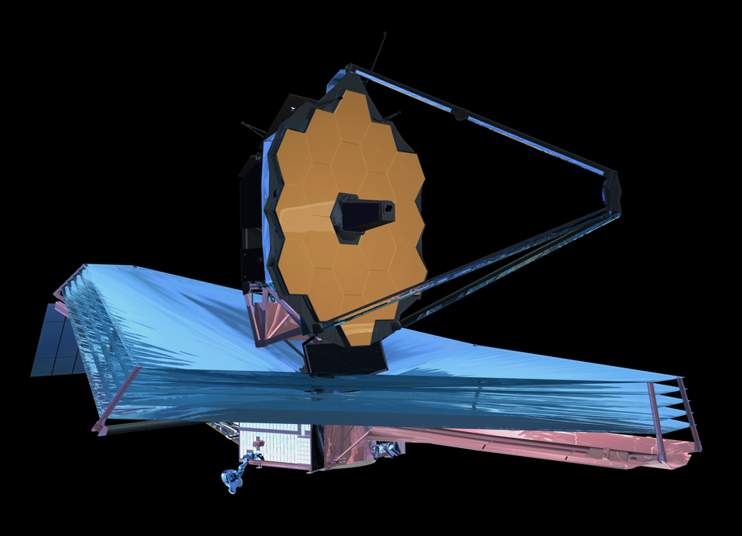
JWST
Science Data Processing Meeting
January 25 & 26, 2010
Space Telescope Science Institute

Slide 2
AGENDA – Day 1
9:00 Welcome
9:15 – 12:10 Organization Science Data Processing Overviews
(Application, Core Technology, Timelines and Resources)
9:15 LSST SDP
9:45 Magellan SDP
10:15 Break
10:30 NOAO SDP
11:00 JDEM SDP
11:30 STScI SDP
12 Noon Lunch
1:30 Other SDP and External Influences
        VO
        GLAST
        AURA/SSW
3:00 Break
3:15 Defining Common Ground
        SDP data model
        Dataset staging mechanisms
        IPC
        Where are the holes
        FITS tile compression
5:00 Adjourn

Slide 3
AGENDA – Day 2
9:00 Summary of Day 1
9:30 Working Meeting (A): Collaboration elements
        Saving Money/Cost Sharing
      Pyraf interface with Python middleware
      Inheriting Application Pipeline
      GUIs & Tools
        Data-centric
      Active Performance monitoring (hw, proc, )
      Pipeline Definition Language (aka Workflow)
        Domain specific language
        Yahoo pipes?
12 Noon Lunch
1:30 Working Meeting (B): Refine Plan & Match Resources
        Where do we go from here
3-4:00 Adjourn

